Slide 1
APPENDIX A AREA MOMENTS OF INERTIA
APPENDIX OUTLINE
A/1 Introduction
A/2 Definitions
A/3 Composite Areas
A/4 Products of Inertia and Rotation of Axes
Jake Wyman/Photonica/Getty Images

Slide 2
Article A/1 Introduction
Origin of the Area Moment of Inertia Calculation
When forces are distributed continuously over an area on which they act, it is often necessary to calculate the moment of these forces about some axis either in or perpendicular to the plane of the area. When this occurs, an area moment of inertia calculation appears which has the form of an integral of a distance squared over an area.
Form of the Calculation
∫(distance)² d(area)

Slide 3
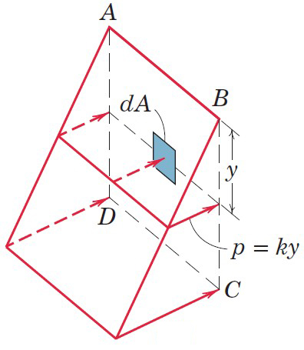
Article A/1 – Physical Origin of the Calculation (1 of 3)
Example with Fluid Pressure
Consider the surface area ABCD which is subjected to a distributed pressure p whose intensity is proportional to the distance y from the axis AB. The pressure at depth in a fluid, p = ρgy, where ρ is the density of the fluid and the pressure is considered relative to the atmospheric pressure.
The pressure at a depth y is equal to some constant k multiplied by the depth. Thus, p = ky.
The pressure p acting over a differential area dA will produce a differential force dF = p dA = ky dA.
The moment of this differential force about the axis AB can be written as dM = y dF = yp dA = ky² dA.
The total moment M = ∫dM = ∫ ky² dA, which has the form of an integral of a distance squared over an area.

Slide 4
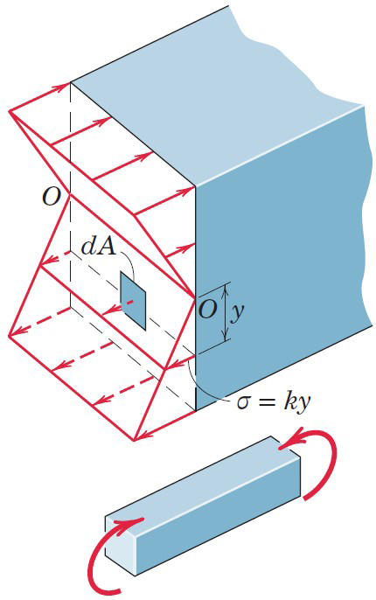
Article A/1 – Physical Origin of the Calculation (2 of 3)
Example with Beams in Bending
Consider the normal stress distribution acting on a transverse section of a simple elastic beam bent by equal and opposite couples applied to its ends.
At any section of the beam, a linear distribution of force intensity or stress σ, given by σ = ky, is present.
The stress is positive (tensile) below the axis O-O and negative (compressive) above the axis. Axis O-O is termed the neutral axis.
The stress σ acting over a differential area dA will produce a differential force dF = σ dA = ky dA.
The moment of this differential force about the axis O-O can be written as dM = y dF = yσ dA = ky² dA.
The total moment M = ∫dM = ∫ ky² dA, which has the form of an integral of a distance squared over an area.

Slide 5
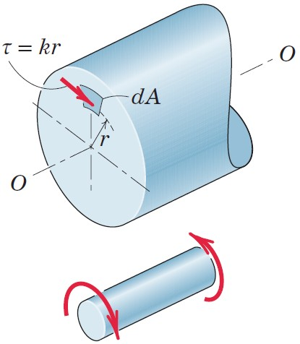
Article A/1 – Physical Origin of the Calculation (3 of 3)
Example with Shafts in Torsion
Consider the shear stress distribution acting on a transverse section of a shaft subjected to equal and opposite torsional moments applied to its ends.
Within the elastic limit of the material, this moment is resisted at each cross section of the shaft by a distribution of tangential or shear stress τ, which is proportional to the radial distance r from the center of the shaft. Thus, τ = kr.
The shear stress τ acting over a differential area dA will produce a differential force dF = τ dA = kr dA.
The moment of this differential force about the shaft axis O-O can be written as dM = r dF = rτ dA = kr² dA.
The total moment M = ∫dM = ∫ kr² dA, which has the form of an integral of a distance squared over an area.

Slide 6
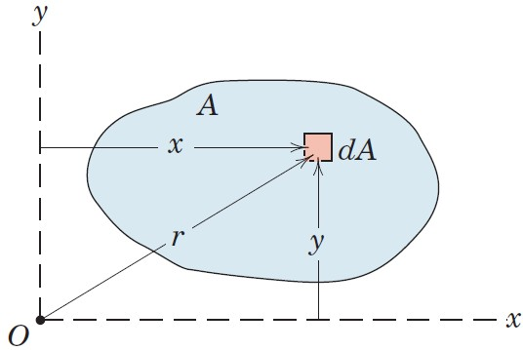
Article A/2 Definitions
Rectangular Moments of Inertia
I_{x} = ∫ y² dA
I_{y} = ∫ x² dA
Polar Moments of Inertia
I_{z} = ∫ r² dA = ∫ x² dA + ∫ y² dA = I_{x} + I_{y}

Slide 7
Article A/2 – Comments about Moments of Inertia
Dimensions and Units
Length to the 4th Power, L⁴
SI Units: mm⁴ (most common)
U.S. Customary Units: in.⁴ (most common)
Things to Note
A moment of inertia is always positive since it involves the square of a distance from the inertia axis to the element of integration.
The choice of coordinates (rectangular or polar) to use for the calculation of moments of inertia is important.

Slide 8
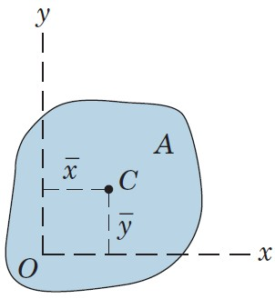
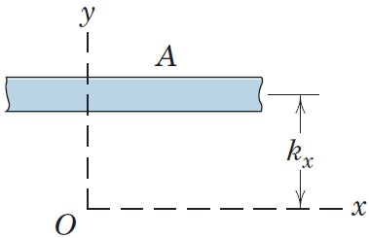
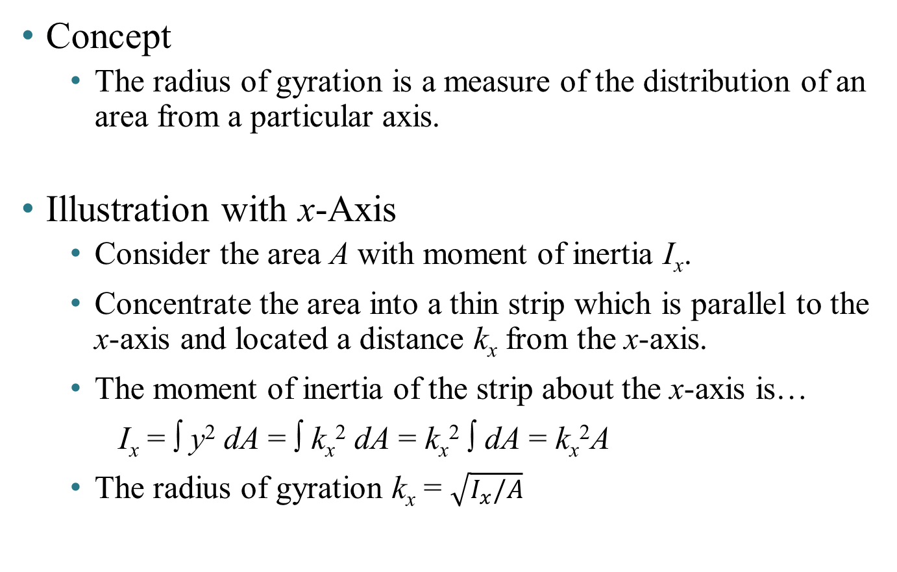
Article A/2 – Radius of Gyration (1 of 3)
Concept
The radius of gyration is a measure of the distribution of an area from a particular axis.
Illustration with x-Axis
Consider the area A with moment of inertia I_{x}.
Concentrate the area into a thin strip which is parallel to the x-axis and located a distance k_{x} from the x-axis.
The moment of inertia of the strip about the x-axis is…
I_{x} = ∫ y² dA = ∫ k_{x}² dA = k_{x}² ∫ dA = k_{x}²A
The radius of gyration k_{x} = $\sqrt{I_{x}/A}$

Slide 9
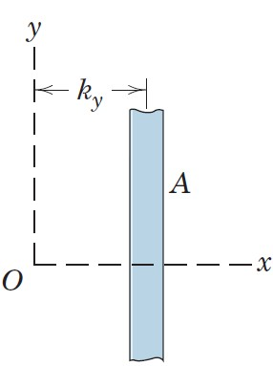
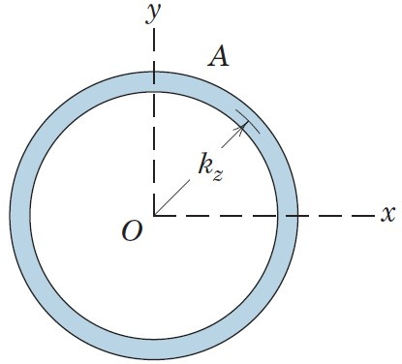
Article A/2 – Radius of Gyration (2 of 3)
Illustration with y-Axis
Illustration with the z-Axis

Slide 10
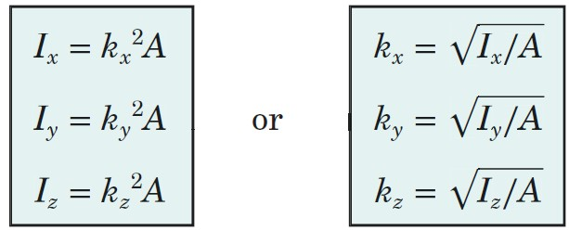
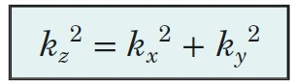
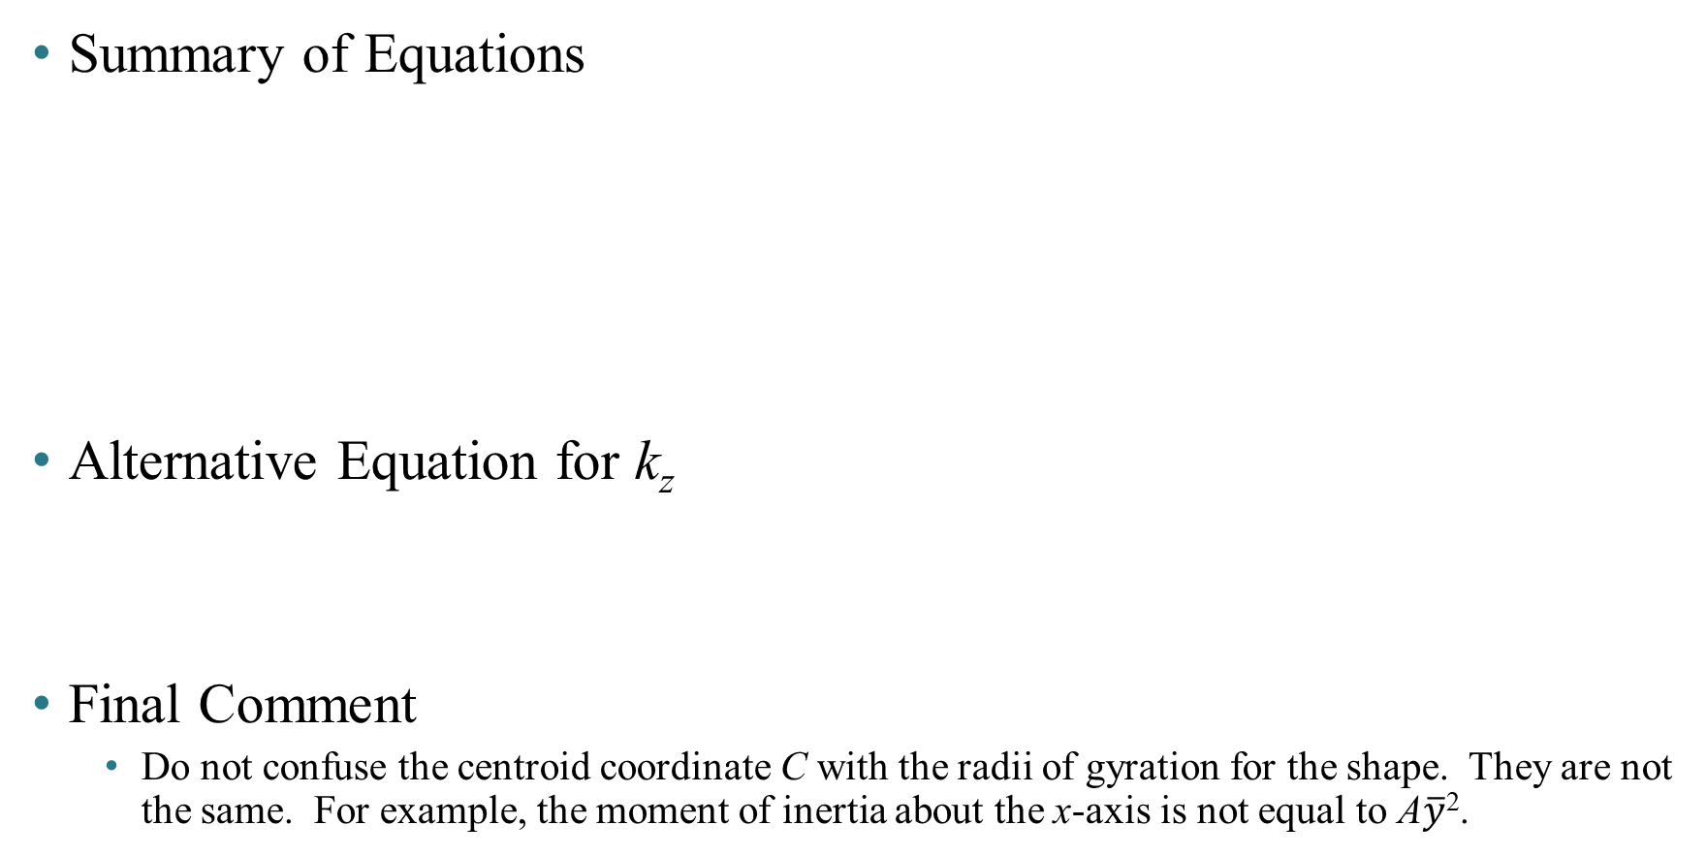
Article A/2 – Radius of Gyration (3 of 3)
Summary of Equations
Alternative Equation for k_{z}
Final Comment
Do not confuse the centroid coordinate C with the radii of gyration for the shape. They are not the same. For example, the moment of inertia about the x-axis is not equal to A$\overline{y}$².

Slide 11
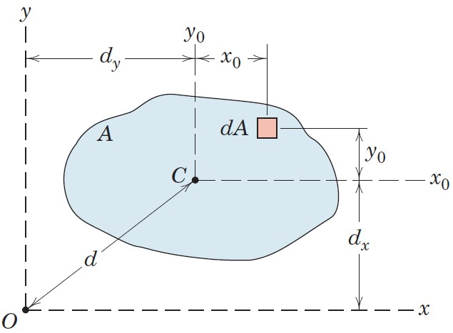
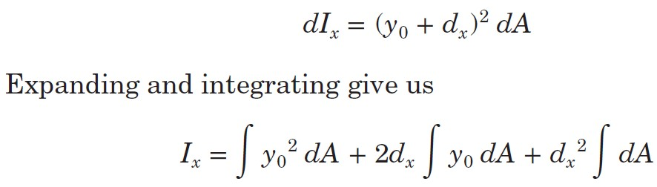
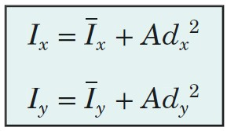
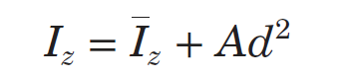
Article A/2 – Transfer of Axes (1 of 2)
Overview
Illustration with the x-Axis
Result
and

Slide 12
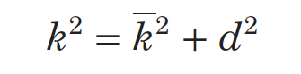
Article A/2 – Transfer of Axes (2 of 2)
Important Comments
The axes between which the transfer is made must be parallel.
One of the axes must pass through the centroid of the area.
Effect on the Radius of Gyration

Slide 13
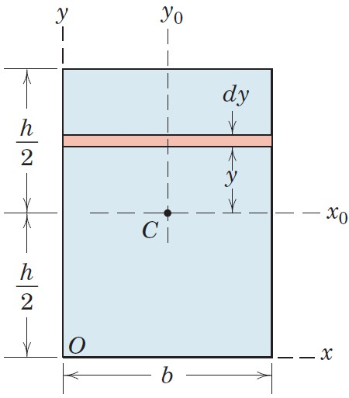
Article A/2 – Sample Problem A/1 (1 of 2)
Problem Statement
Determine the moments of inertia of the rectangular area about the centroidal x₀- and y₀-axes, the centroidal polar axis z₀ through C, the x-axis, and the polar axis z through O.

Slide 14
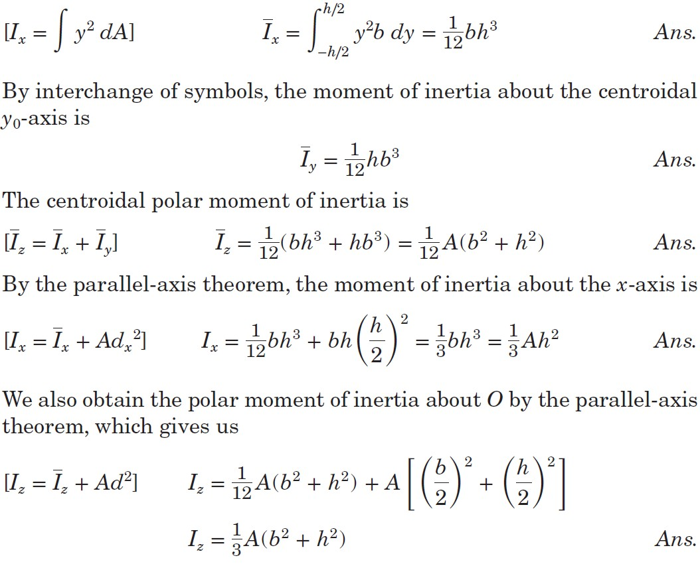
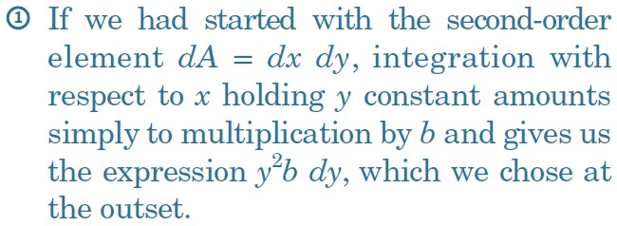
Article A/2 – Sample Problem A/1 (2 of 2)
Horizontal Strip of Area dA = b dy

Slide 15
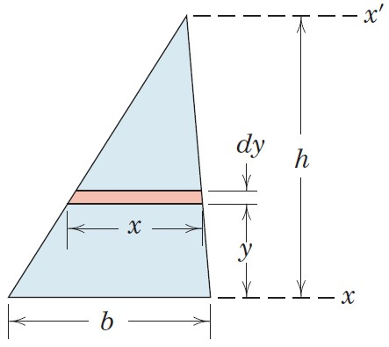
Article A/2 – Sample Problem A/2 (1 of 2)
Problem Statement
Determine the moments of inertia of the triangular area about its base and about parallel axes through its centroid and vertex.

Slide 16
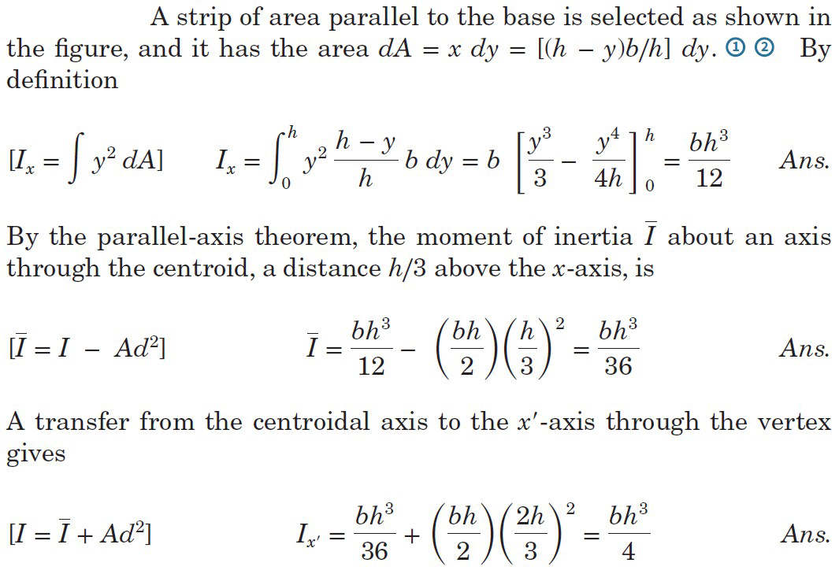
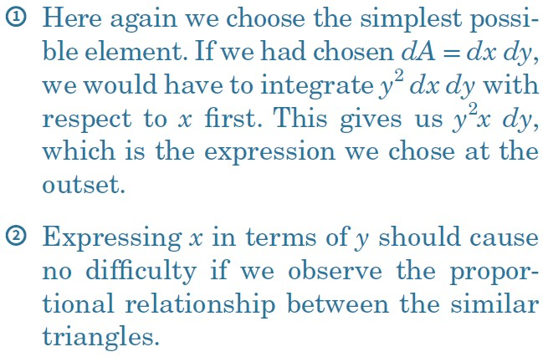
Article A/2 – Sample Problem A/2 (2 of 2)
Solution

Slide 17
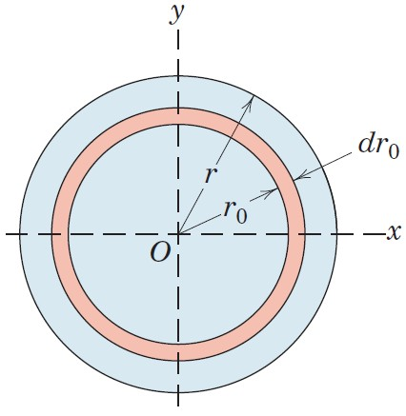
Article A/2 – Sample Problem A/3 (1 of 3)
Problem Statement
Calculate the moments of inertia of the area of a circle about a diametral axis and about the polar axis through the center. Specify the radii of gyration.

Slide 18
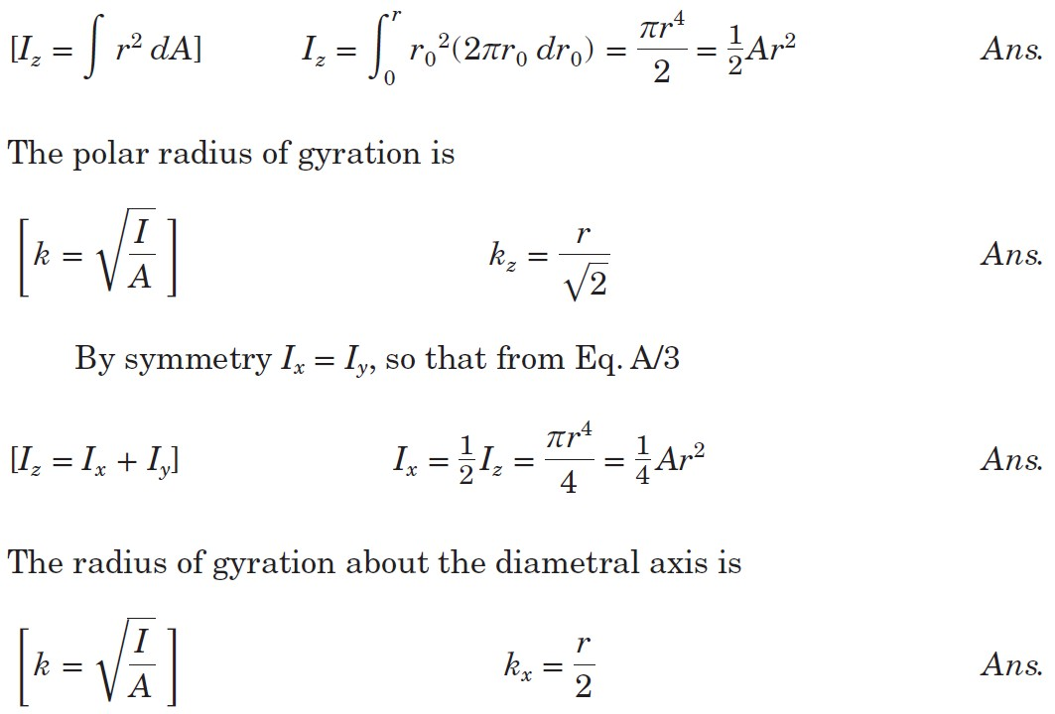
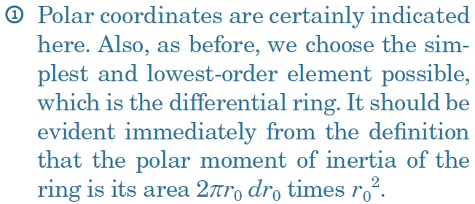
Article A/2 – Sample Problem A/3 (2 of 3)
Circular Ring of Area dA = 2πr₀dr₀

Slide 19
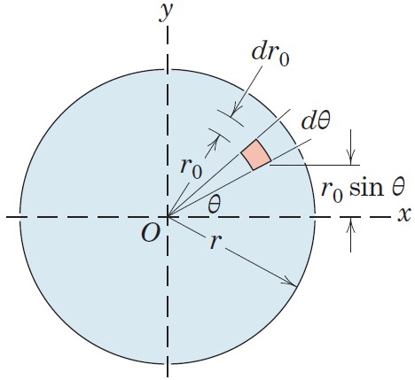
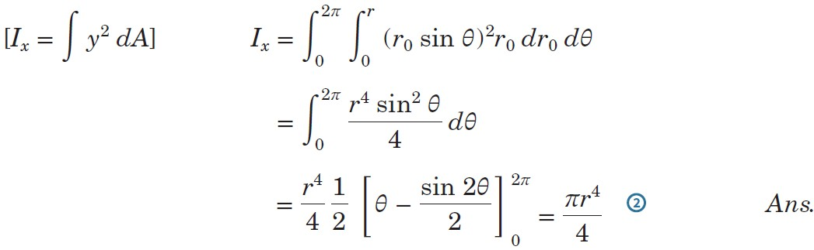
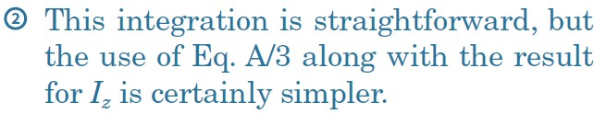
Article A/2 – Sample Problem A/3 (3 of 3)
Alternative Solution for Inertia about x-Axis
Element of Area dA = πr₀dr₀dθ

Slide 20
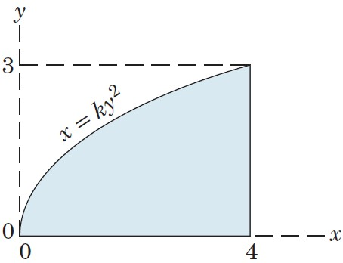
Article A/2 – Sample Problem A/4 (1 of 3)
Problem Statement
Determine the moment of inertia of the area under the parabola about the x-axis. Solve by using (a) a horizontal strip of area and (b) a vertical strip of area.

Slide 21
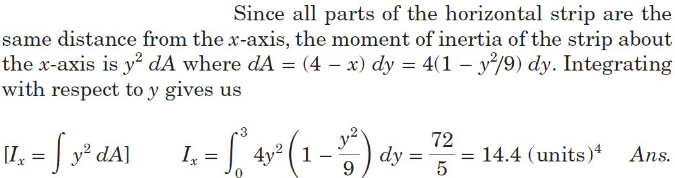
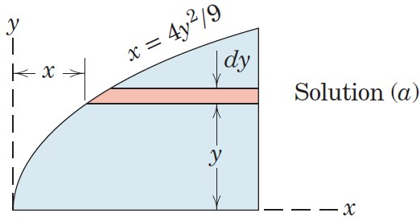
Article A/2 – Sample Problem A/4 (2 of 3)
Equation of the Parabola
The constant k = 4/9 is obtained first by substituting x = 4
and y = 3 into the equation for the parabola.
(a) Solution using a Horizontal Strip

Slide 22
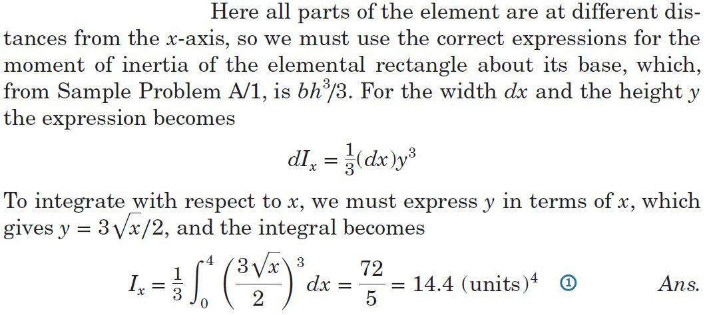
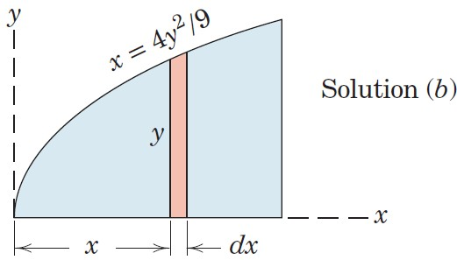
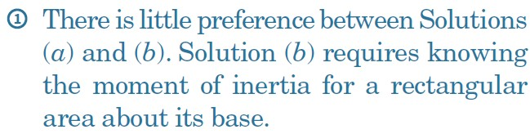
Article A/2 – Sample Problem A/4 (3 of 3)
(b) Solution using a Vertical Strip

Slide 23
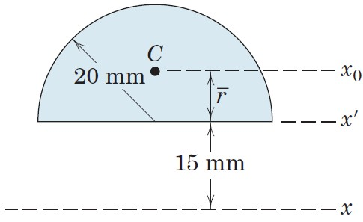
Article A/2 – Sample Problem A/5 (1 of 2)
Problem Statement
Find the moment of inertia about the x-axis of the semicircular area.

Slide 24
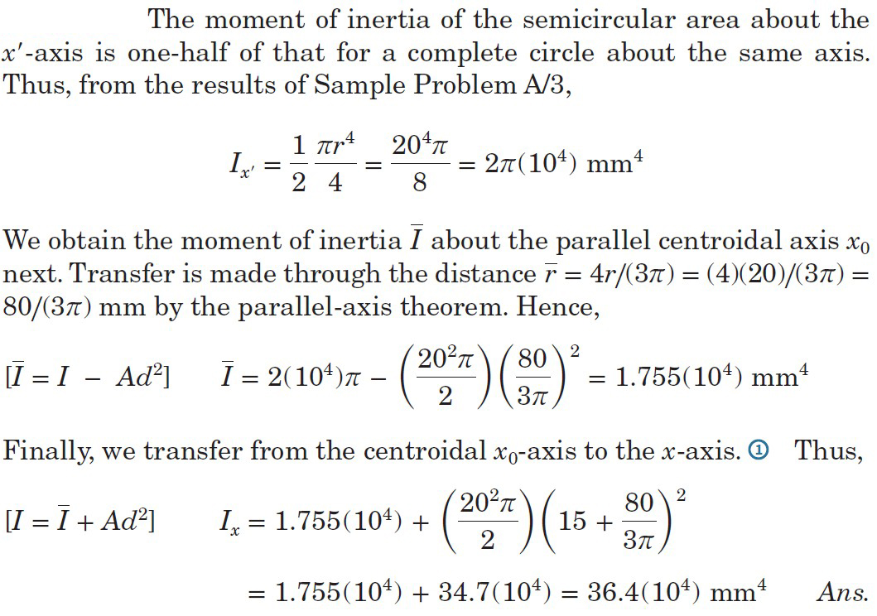
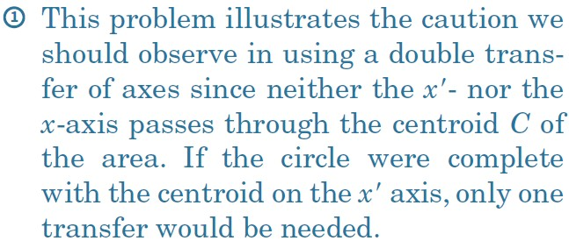
Article A/2 – Sample Problem A/5 (2 of 2)
Solution

Slide 25
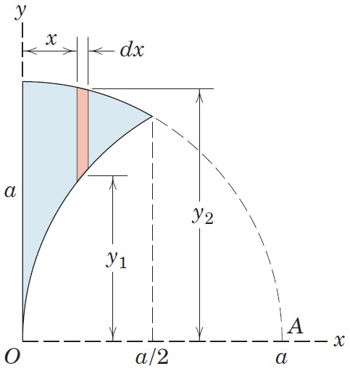
Article A/2 – Sample Problem A/6 (1 of 4)
Problem Statement
Calculate the moment of inertia about the x-axis of the area enclosed between the y-axis and the circular arcs of radius a whose centers are at O and A.

Slide 26
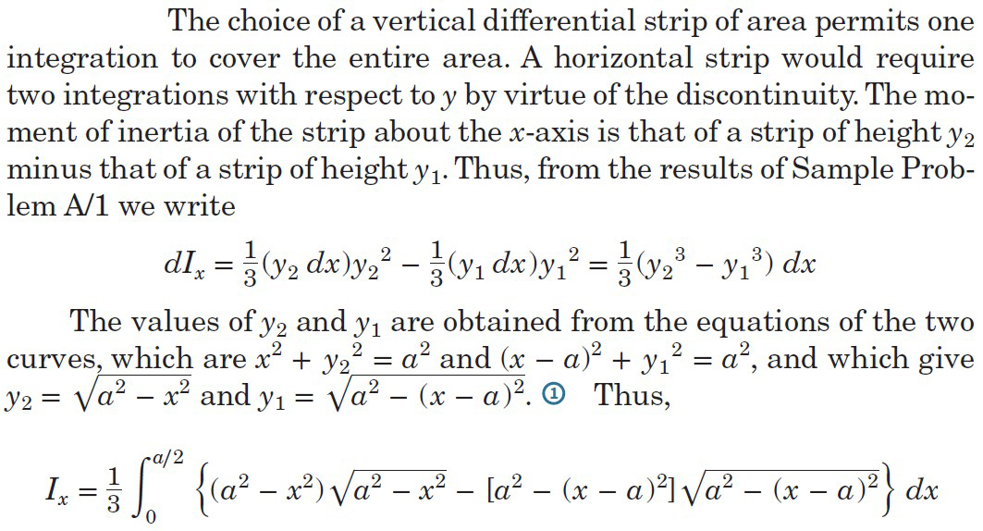
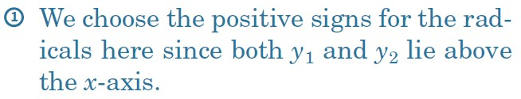
Article A/2 – Sample Problem A/6 (2 of 4)
Solution

Slide 27
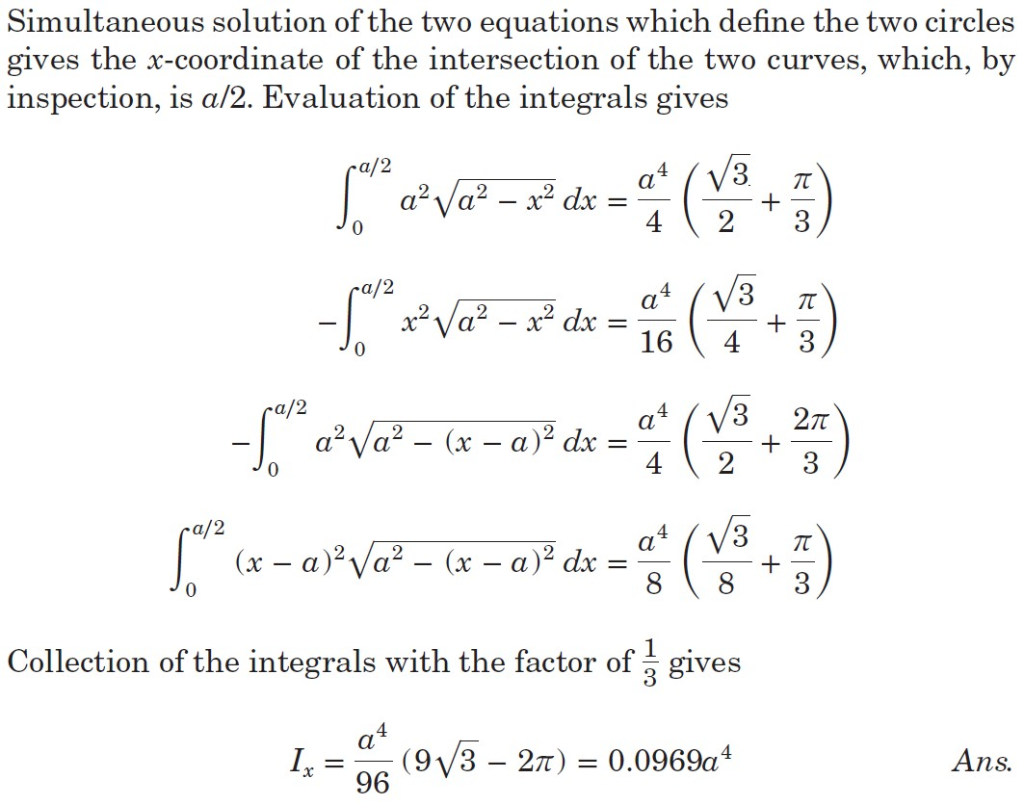
Article A/2 – Sample Problem A/6 (3 of 4)
Solution (cont.)

Slide 28
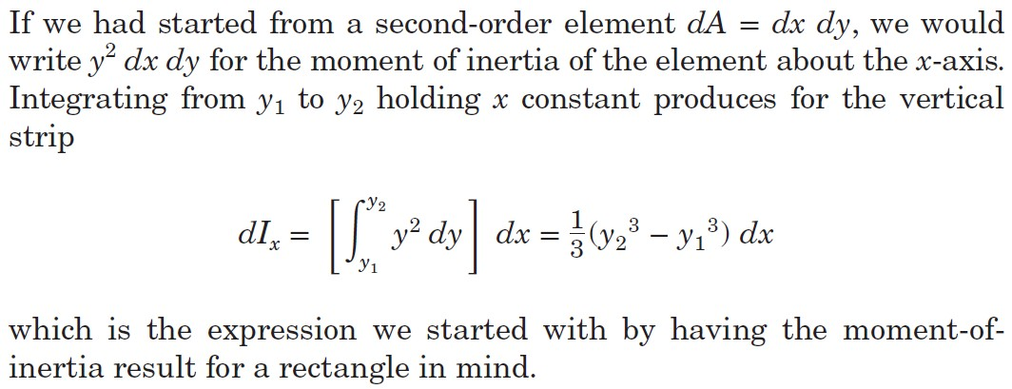
Article A/2 – Sample Problem A/6 (4 of 4)
Alternative Element Form

Slide 29
Article A/3 Composite Areas
Introduction
It is frequently necessary to calculate the moment of inertia of an area composed of a number of distinct parts of simple and calculable geometric shape.
The moment of inertia of a composite area about a particular axis is simply the sum of the moments of inertia of its component parts about the same axis.
It is convenient to regard a composite area as being composed of positive and negative parts. We may then treat the moment of inertia of a negative area (hole or cutout) as a negative quantity.
Tabulated inertias and a systematic approach prove quite useful for these calculations.

Slide 30
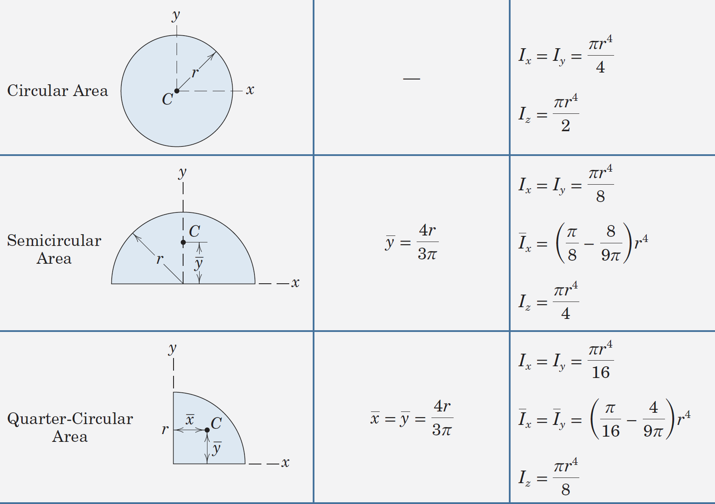
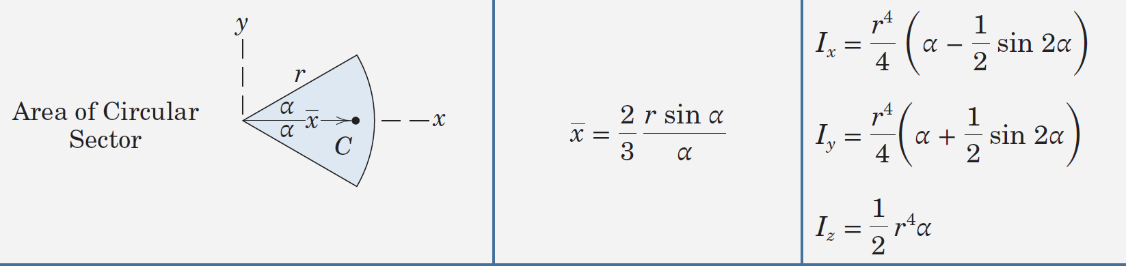
Article A/3 – Inertias of Common Shapes (1 of 3)

Slide 31
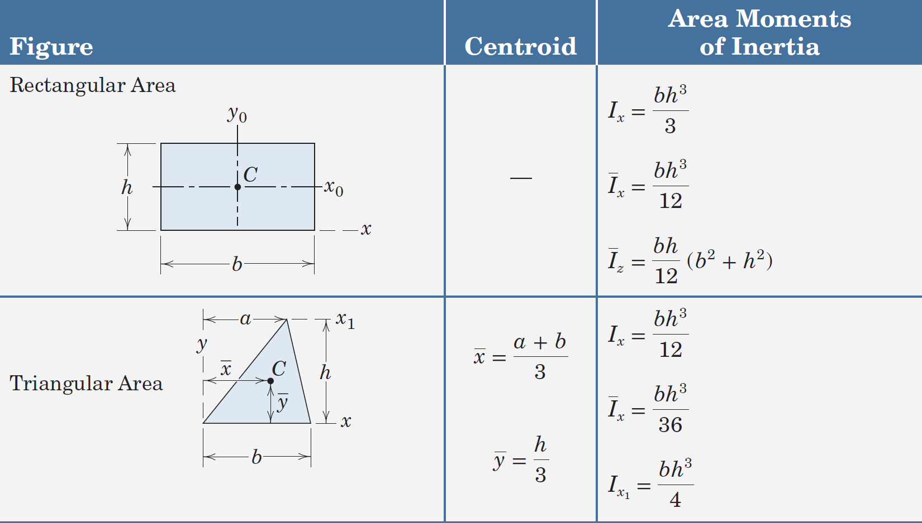
Article A/3 – Inertias of Common Shapes (2 of 3)

Slide 32
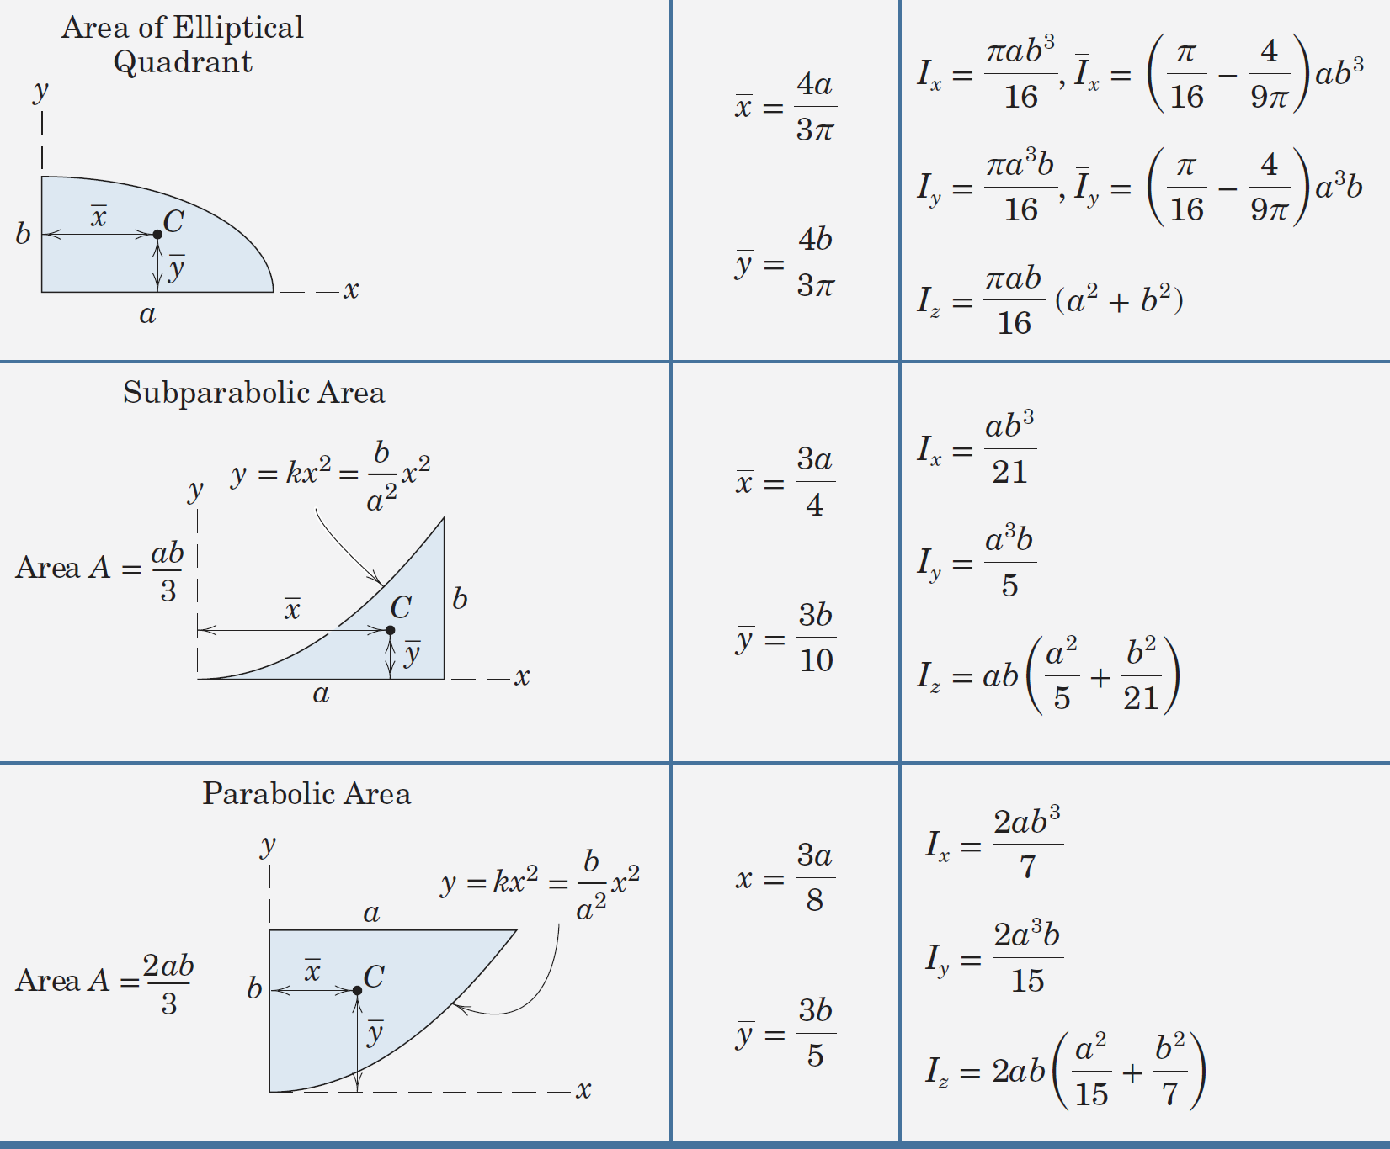
Article A/3 – Inertias of Common Shapes (3 of 3)

Slide 33
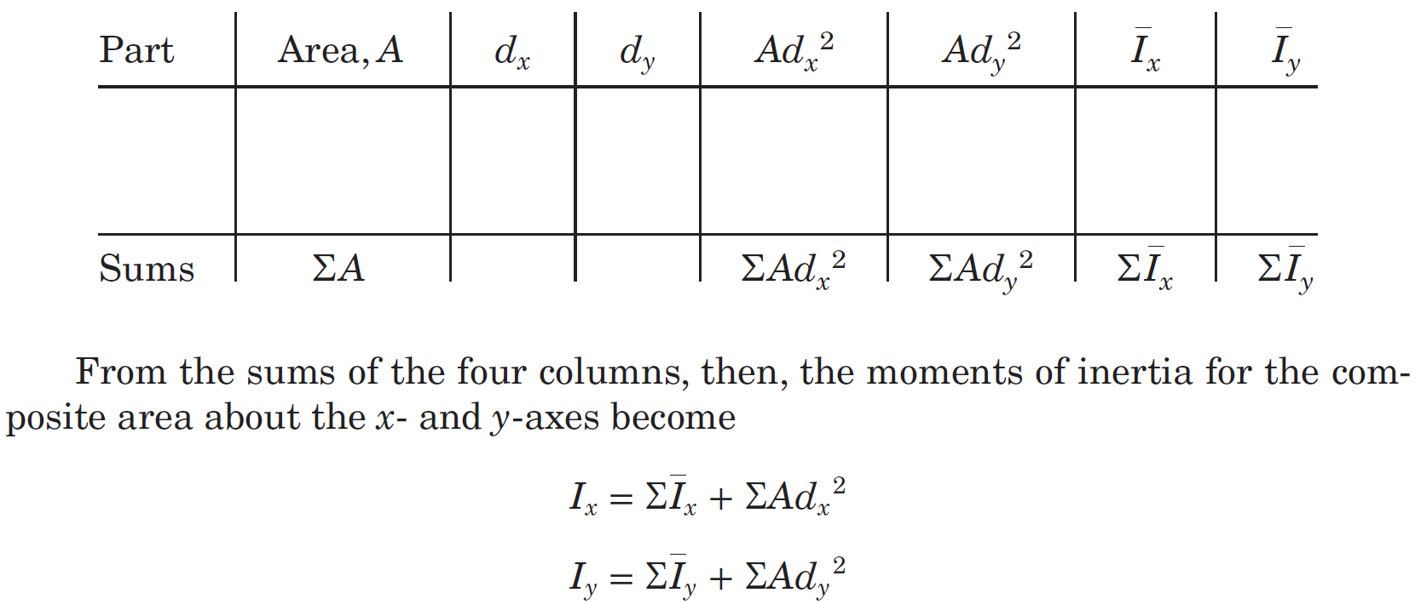
Article A/3 – Typical Solution Process
Tabulated Approach

Slide 34
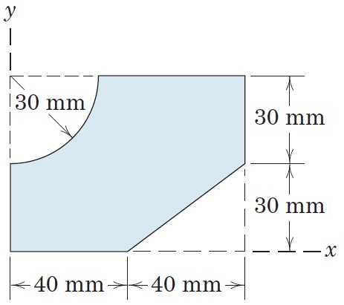
Article A/3 – Sample Problem A/7 (1 of 2)
Problem Statement
Determine the moments of inertia about the x- and y-axes for the shaded area. Make direct use of the expressions given in Table D/3 for the centroidal moments of inertia of the constituent parts.

Slide 35
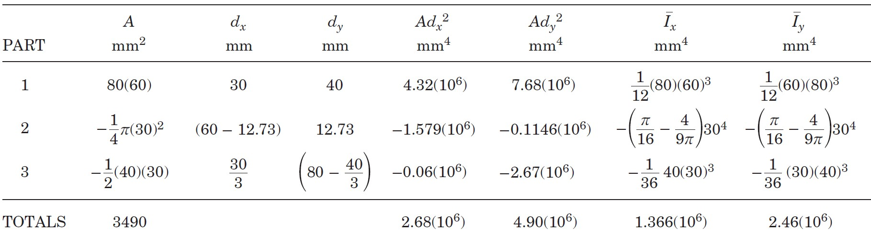


Article A/3 – Sample Problem A/7 (2 of 2)
Composite Shapes
Rectangular Area (1)
Quarter-Circular Cutout (2)
Triangular Cutout (3)
Tabulated Values

Slide 36

Article A/3 – Sample Problem A/8 (1 of 4)
Problem Statement
Calculate the moment of inertia and radius of gyration about the x-axis for the shaded area shown. Wherever possible, make expedient use of tabulated moments of inertia.

Slide 37


Article A/3 – Sample Problem A/8 (2 of 4)
Composite Shapes
Rectangular Area (1)
Quarter-Circular Cutout (2)
Triangular Cutout (3)
Inertia for the Rectangular Area

Slide 38



Article A/3 – Sample Problem A/8 (3 of 4)
Inertia for the Quarter-Circular Cutout

Slide 39



Article A/3 – Sample Problem A/8 (4 of 4)
Inertia for the Triangular Cutout
Total Inertia and Radius of Gyration

Slide 40
Article A/4 Products of Inertia and Rotation of Axes
Definition
I_{xy} = ∫ xy dA
Dimensions and Units
Length to the 4th Power, L⁴
SI Units: mm⁴ (most common)
U.S. Customary Units: in.⁴ (most common)

Slide 41

Article A/4 – Comments About Products of Inertia
A product of inertia can be positive, negative, or zero.
The product of inertia is zero whenever either of the reference axes is an axis of symmetry. This is illustrated in the figure at right where the area is symmetric about the x-axis.

Slide 42


Article A/4 – Transfer of Axes
Overview
Mathematics
Result

Slide 43


Article A/4 – Rotation of Axes (1 of 4)
Introduction
Moments of Inertia about Tilted Axes

Slide 44


Article A/4 – Rotation of Axes (2 of 4)
Trigonometric Identities of Importance
Substitution and Simplification

Slide 45

Article A/4 – Rotation of Axes (3 of 4)
Product of Inertia about Tilted Axes
Trigonometric Identities of Importance
Substitution and Simplification

Slide 46



Article A/4 – Rotation of Axes (4 of 4)
Angle for Principal Axes of Inertia
Principal Moments of Inertia

Slide 47

Article A/4 – Mohr’s Circle of Inertia (1 of 2)
Illustration

Slide 48
Article A/4 – Mohr’s Circle of Inertia (2 of 2)
Procedure
Sketch a horizontal axis for the measurement of moments of inertia and a vertical axis for the measurement of products of inertia.
Plot point A which has coordinates (I_{x}, I_{xy}) and point B which has coordinates (I_{y}, -I_{xy}).
Sketch a line between points A and B and then draw a circle with these two points as the extremities of a diameter.
Calculated Quantities
The angle from radius OA to the horizontal axis is 2α or twice the angle from the x-axis of the area in question to the axis of maximum moment of inertia. The angle on the diagram and the angle on the area are both measured in the same sense.
The coordinates of any point C are (I_{x′}, I_{x′y′}), and those of corresponding point D are (I_{y′}, -I_{x′y′}), and can be found by rotating the diametral line sketched previously through the angle 2θ in the correct sense.
The radius of the circle, maximum and minimum moments of inertia, and intermediate moments of inertia can be calculated using the geometry of the sketch.

Slide 49

Article A/4 – Sample Problem A/9 (1 of 2)
Problem Statement
Determine the product of inertia of the rectangular area with centroid at C with respect to the x-y axes parallel to its sides.

Slide 50

Article A/4 – Sample Problem A/9 (2 of 2)
Solution

Slide 51

Article A/4 – Sample Problem A/10 (1 of 3)
Problem Statement
Determine the product of inertia about the x-y axes for the area under the parabola.

Slide 52
Article A/4 – Sample Problem A/10 (2 of 3)
Equation of the Parabola
Second-Order Element dA = dxdy

Slide 53




Article A/4 – Sample Problem A/10 (3 of 3)
First Order Element, Vertical Strip
First Order Element, Horizontal Strip

Slide 54

Article A/4 – Sample Problem A/11 (1 of 2)
Problem Statement
Determine the product of inertia of the semicircular area with respect to the x-y axes.

Slide 55


Article A/4 – Sample Problem A/11 (2 of 2)
Solution

Slide 56

Article A/4 – Sample Problem A/12 (1 of 5)
Problem Statement
Determine the orientation of the principal axes of inertia through the centroid of the angle section and determine the corresponding maximum and minimum moments of inertia.

Slide 57


Article A/4 – Sample Problem A/12 (2 of 5)
Products of Inertia
Products of Inertia for the rectangles about their own centroidal axes are zero.

Slide 58

Article A/4 – Sample Problem A/12 (3 of 5)
Moments of Inertia

Slide 59

Article A/4 – Sample Problem A/12 (4 of 5)
Principal Axes

Slide 60


Article A/4 – Sample Problem A/12 (5 of 5)
Mohr’s Circle of Inertia Plot

